Slide 1
Introduction to Python

Slide 2
Contents
History of Python
What is Python
Features of Python
Uses of Python
Installation of Python
Data types
Operators of Python

Slide 3
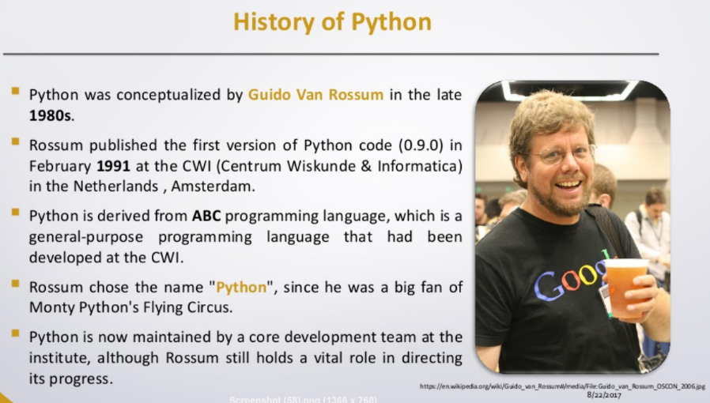

Slide 4
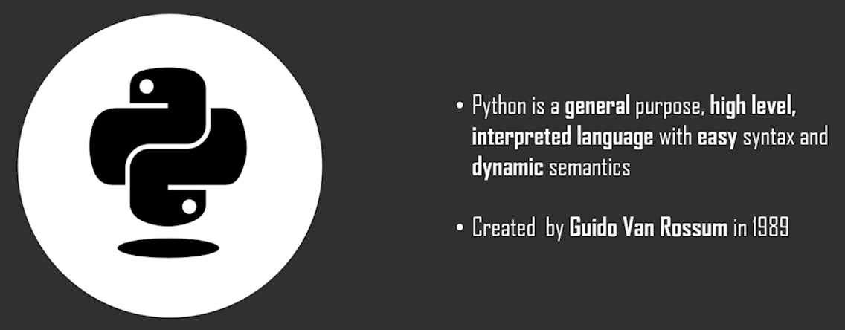

Slide 5

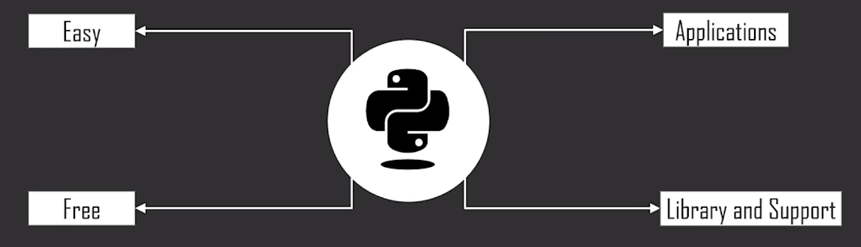

Slide 6
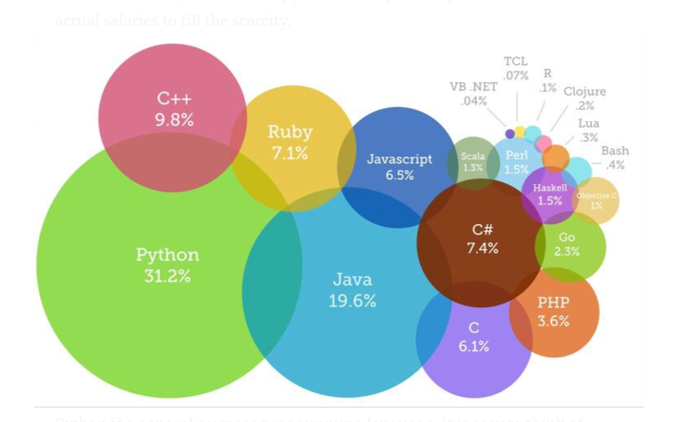
Most Trending Programming Languages of 2020

Slide 7
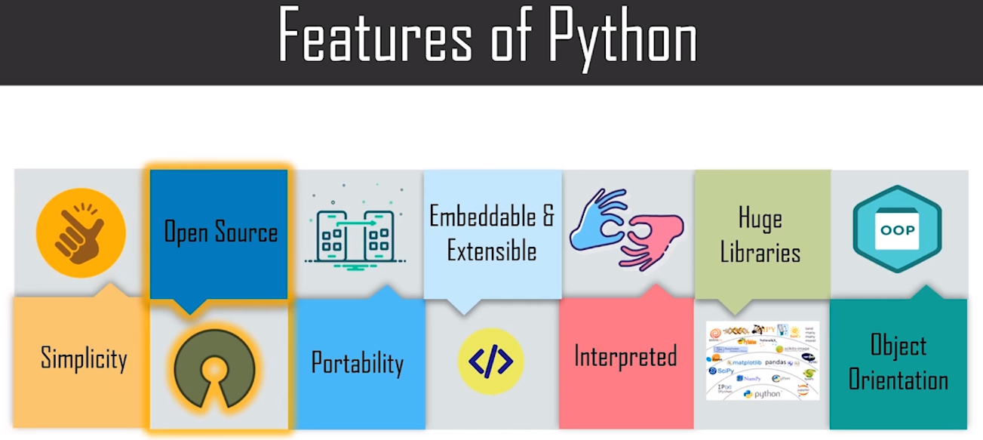

Slide 8
Application of Python
Scripting
Web Development
Testing
Computer Vision(Desktop Application)
Database Application
Data Science
Machine Learning
Artificial Intelligence
GUI and Game Development
Image Processing
Enterprise Applications
Robotics
Network Programming

Slide 9
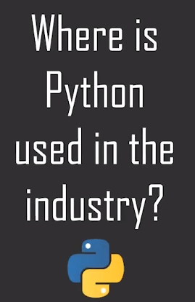
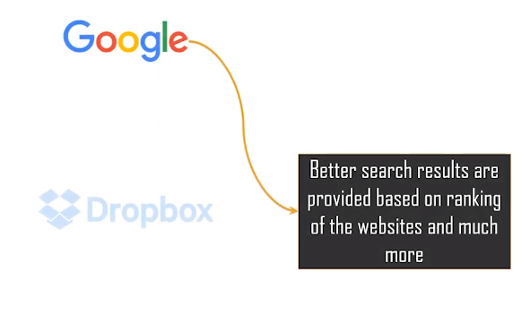

Slide 10
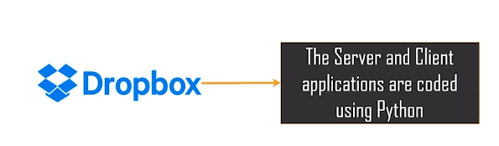

Slide 11
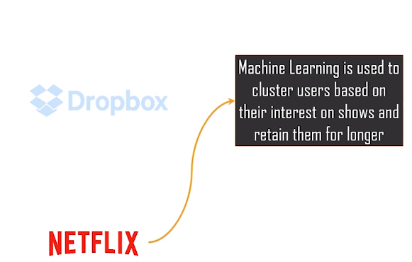

Slide 12
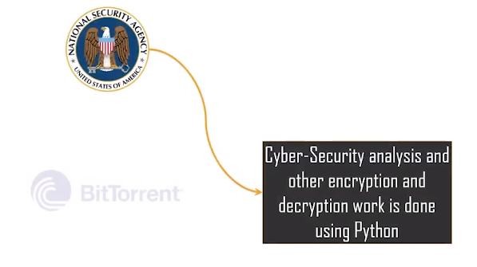

Slide 13
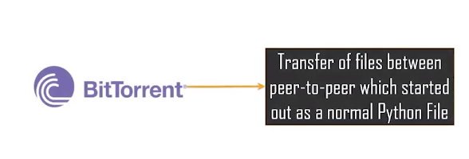

Slide 14
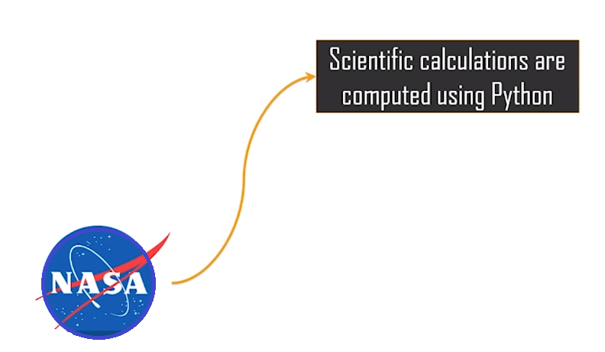

Slide 15
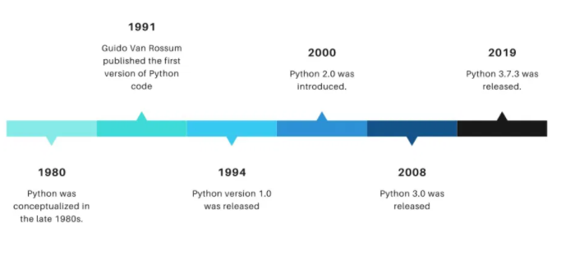
Python Versions

Slide 16
Installation of Python

Slide 17
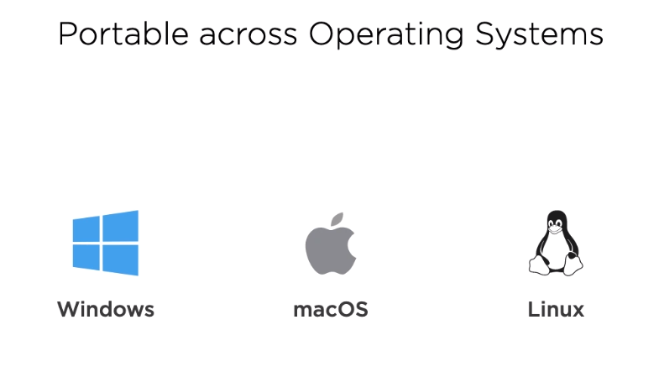

Slide 18
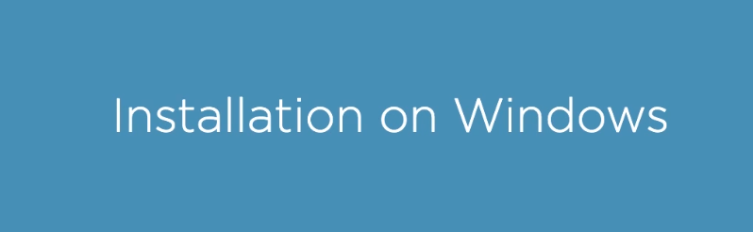

Slide 19
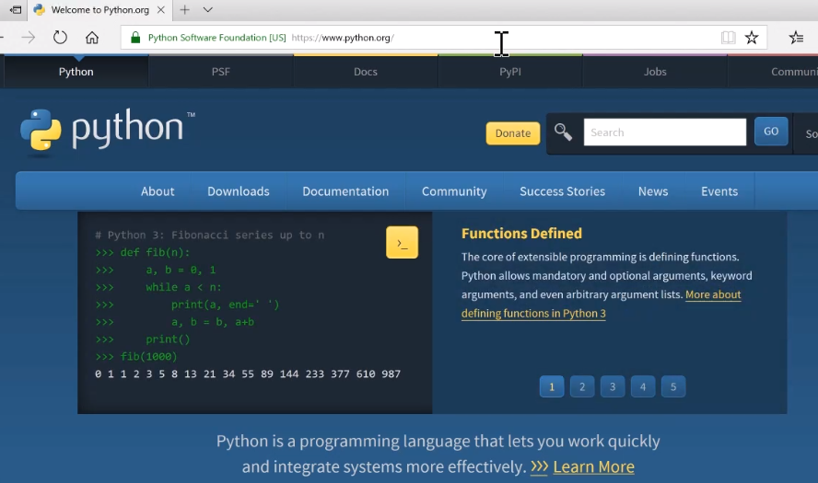

Slide 20
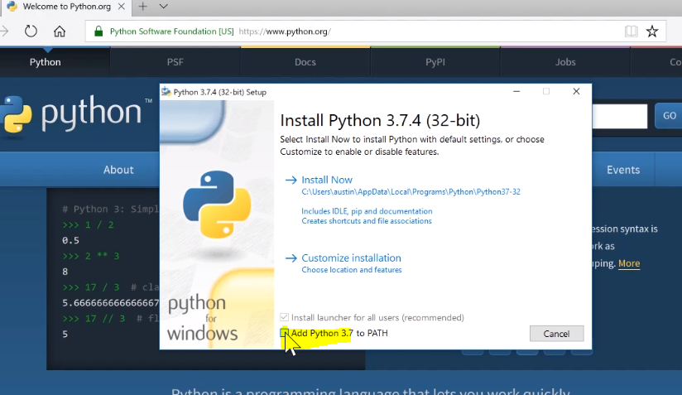

Slide 21
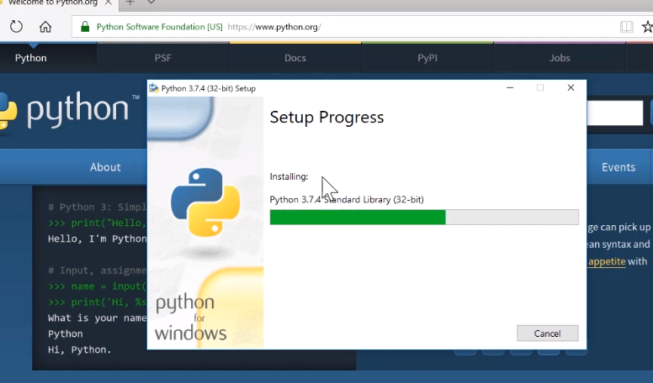

Slide 22
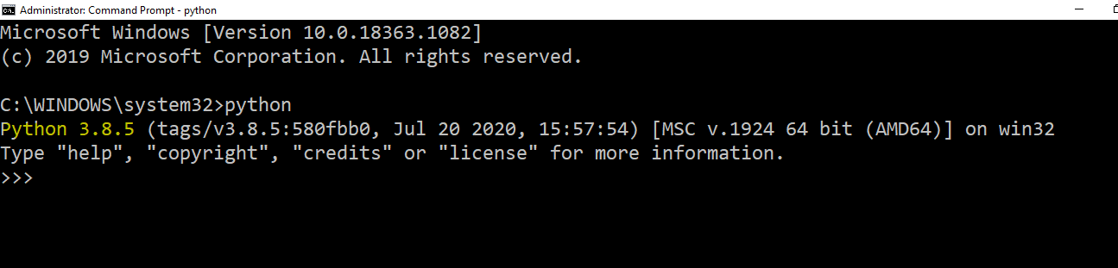

Slide 23
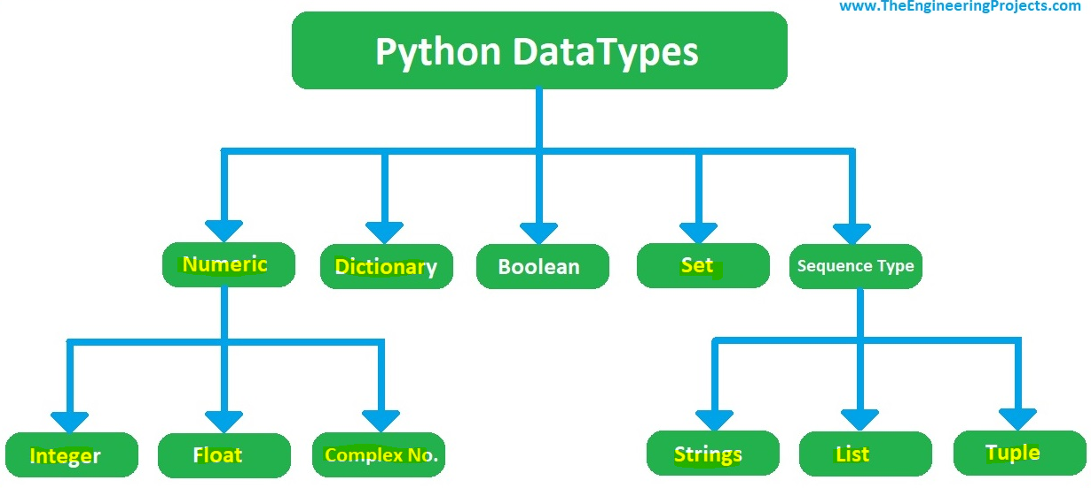

Slide 24
1.Numeric Data types:
a = 10
b = 3.142
c = 10+6j
print(int(b), float(a), str(c))
a = 10
b = 3.142
c = 10+6j
print(int(b), float(a), str(c))
a = 10
b = 3.142
c = 10+6j
i)Int: Integer values in the variable e.g int=20
ii)Float: Float is represented by decimal values e.g float=3.2
iii)Complex: It contains real and imaginary part e.g complex=12+4j
Conversation of data types
Example:
a=20
b=3.142
c=10+6j
print(int(b),float(a),string(c))

Slide 25
2.List data types
List data type is used to collect an ordered data or store a multiple data in single variable
List data is displayed with square brackets
Syntax fruits list=[“apple”,”banana”,”orange”,”mango”]
Index 0 1 2 3
List is mutable i.e it can be changed
It allows Duplicates
Similor syntax abc=list() ,abc=[]

Slide 26
Various operation in lists
Syntax fruits list=[“apple”,”banana”,”orange”,”mango”]
list.insert(1,”grapes”) #insert grapes in place of order 1
list.remove(“apple”) #remove the apple in list
list.index(“banana”)#it shows index or order of the banana
list.count(“apple”)#it count number of apple in list
list.pop(3)#it perform pop operation
list.sort()
list.clear()
del.ist[2]#delete the 2nd index in list

Slide 27
3.Tuple data types:
Tuple is a data type is used to store a multiple data in a single variable
Syntax tuple=(“apple”,”mango”,”grapes”)
Tuples are immutable i.e can’t be changed
Tuples allows duplicates
Various operation in tuples
tuple=tuple*2 #print tuple in twice
print(tuple[0:2])#print order 0 to 2

Slide 28
4.Set data types:
Sets are used to store multiple items in a single variable
Sets are unordered collection of data
Sets are displayed with curlybrackets
Syntax a={1,5,2,3,6,4}
b={5,2,4,6,7}
Sets are immutable
Duplicates are not allowed

Slide 29
Various operation in sets:
a = {1, 2, 3, 4, 4, 4}
b = {3, 4, 5, 6}
a={1,2,3,4,4,4} b={3,4,5,6}
Print(a & b) Intersection operation where only the elements present in both sets are selected. {3, 4}
Print(a | b) Union operation where all the elements of the sets are combined {1, 2, 3, 4, 5, 6}
Print(a – b) Difference operation where the elements present in ‘a’ and ‘b’ are deleted and remaining elements of ‘a’ is the result. {1, 2}
Print(a ^ b) Symmetric difference operation where the intersecting elements are deleted and the remaining elements in both sets is the result. {1, 2, 5, 6}

Slide 30
5.Dictionary
Dictionaries are used to store values in key value pairs
It can be ordered
Dictionaries are mutable i.e changeable
Duplicates are not allowed
Syntax a=dict() or a={}
thisdict = {"brand": "Ford", "model": "Mustang", "year": 1964} print(thisdict)

Slide 31
6.Strings
Strings in python are surrounded by either single or double quotation
Strings in python are immutable.
Syntax str=“Hello Avyukti good morning have a nice day”
Various operation in strings
Print(len(str)) #leanth of the string
Print(str.index(‘t’))#index of the ‘t’
Print(str.count(‘o’))#count number of o
Print(str.upper())#display in uppercase
Print(str.lower())#display in lower case
Print(str.replace(‘’,’’))#seprated with comma

Slide 32
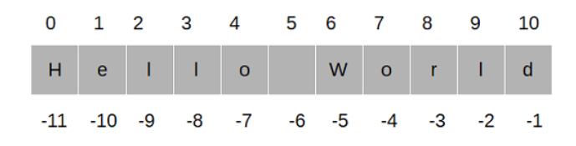
String slicing
S=“Hello World”
Print(s[1:4])#output ell
Print(s[1:])#output ello World
Print(s[1:-4])#output ello wo
Print(len(s))#len of the string

Slide 33
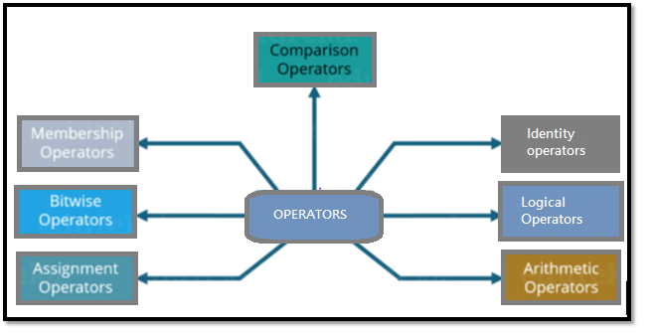
Python Operators Operators are used to perform operations on variables and values.

Slide 34
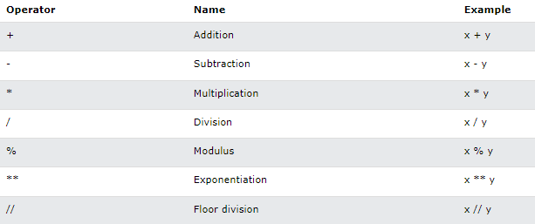
Arithmetic Operators Arithmetic operators are used with numeric values to perform common mathematical operations:

Slide 35
Example #Arithmetic operators x=5 y=2 print (x+y, x-y, x*y, x/y, x%y, x**y) Output: 7 3 10 2.5 1 25

Slide 36
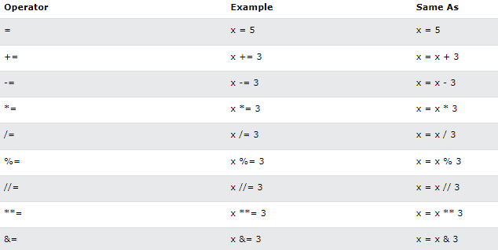
Python Assignment Operators Assignment operators are used to assign values to variables:

Slide 37
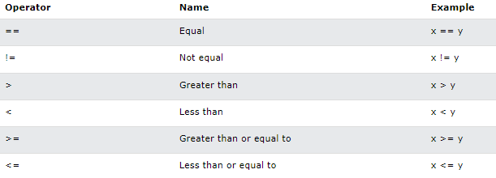
Python Comparison Operators Comparison operators are used to compare two values:

Slide 38
Example
#comparision operators
x=4
y=7
if x==y:
print('x is equal to y')
if x<y:
print('x is less than y ')
if x>y:
print('x is greater than y')
if x>=y:
print('x is greater than or equal to y')
if x<=y:
print('x is less than or equal to y’)
Output: x is less than y
x is less than or equal to y

Slide 39
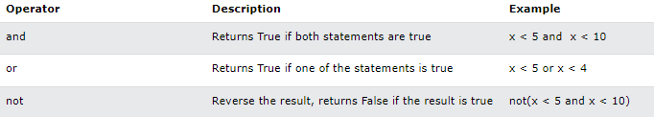
Python Logical Operators Logical operators are used to combine conditional statements:

Slide 40
Example #Logical Operators a = True b = False print(a and b, a or b, not a) Output:False True False

Slide 41
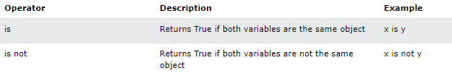
Python Identity Operators Identity operators are used to compare the objects, not if they are equal, but if they are actually the same object, with the same memory location:

Slide 42
Example: #Identity operator a = 5 b = 5 if a is b: print('Similar') if a is not b: print('Not Similar!’) Output: Similar

Slide 43
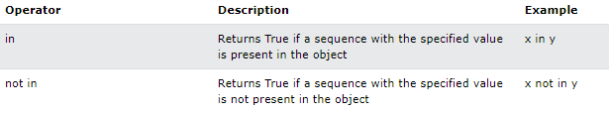
Python Membership Operators Membership operators are used to test if a sequence is presented in an object

Slide 44
Example: #Membership Operator a = [1, 2, 3, 4] if 5 in a: print('Yes!') if 5 not in a: print('No!’) Output: No!

Slide 45
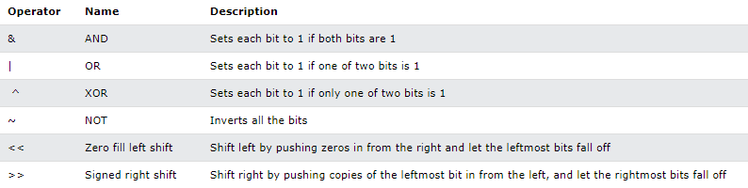
Python Bitwise Operators Bitwise operators are used to compare (binary) numbers:

Slide 46
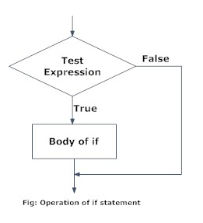
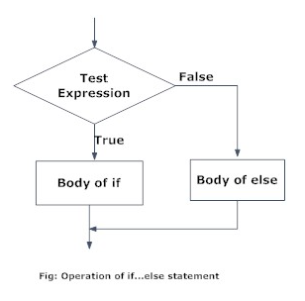
If and Else Statement in Python

Slide 47
If Statements a = 200 b = 330 if b > a: print("b is greater than a") Output: b is greater than a Else Statements a = 200 b = 33 if b > a: print("b is greater than a") else: print("b is not greater than a") Output: b is not greater than a Nested If statement x = 41 if x > 10: print("Above ten,") if x > 20: print("and also above 20!") else: print("but not above 20.") Output: Above ten, and also above 20!

Slide 48
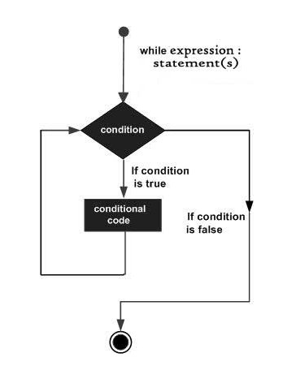
While Loop With the while loop we can execute a set of statements as long as a condition is true.
Example
While Loops
i = 1
while i < 6:
print(i)
i += 1
Output: 1
2
3
4
5

Slide 49
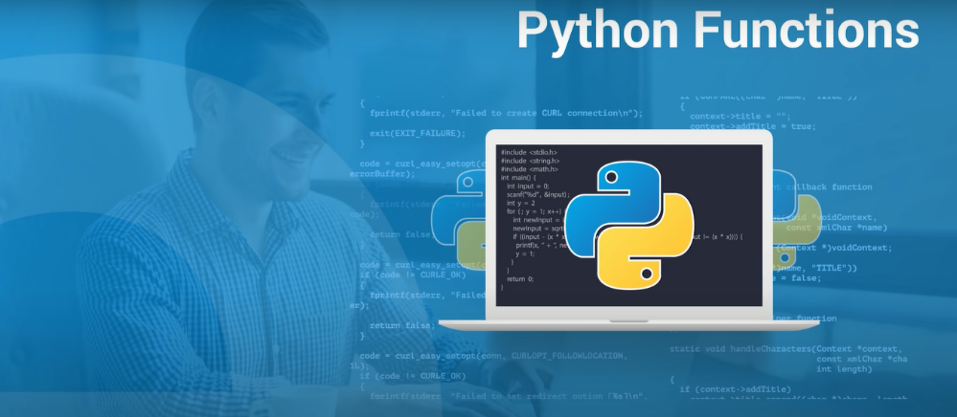
A function is a block of organized, reusable code that is used to perform a single, related action. Functions provide better modularity for your application and a high degree of code reusing.

Slide 50
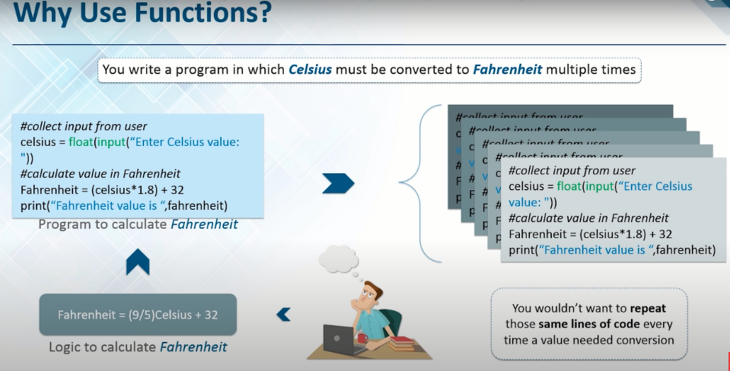

Slide 51
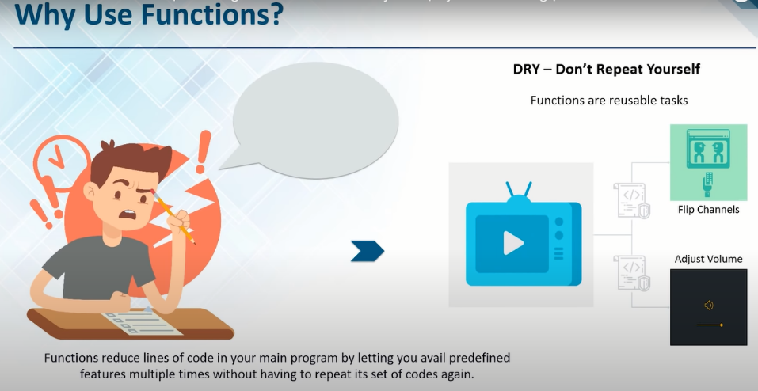

Slide 52
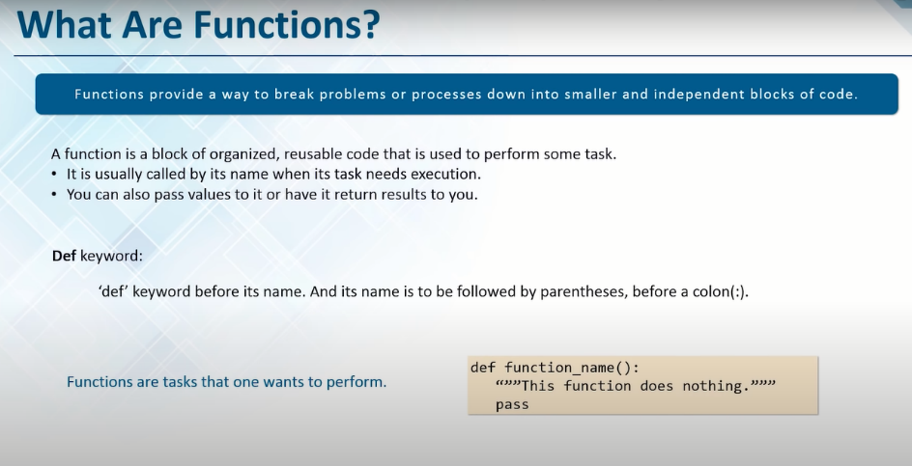

Slide 53
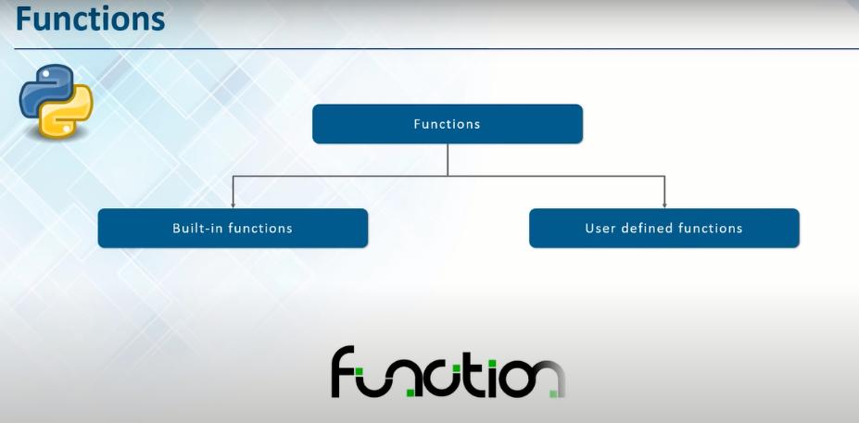

Slide 54
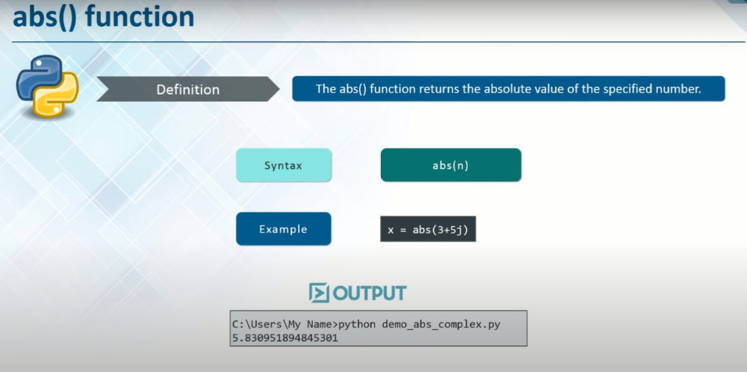
:Python Built-in Functions: The Python interpreter has a number of functions that are always available for use. These functions are called built-in functions. In Python 3.6, there are 68 built-in functions..

Slide 55
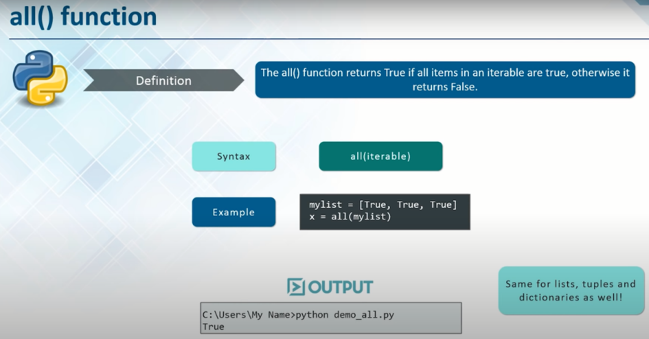

Slide 56
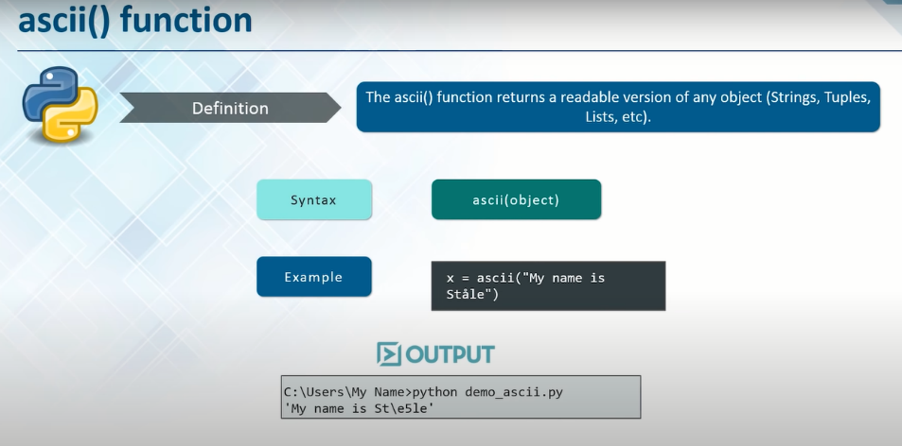

Slide 57
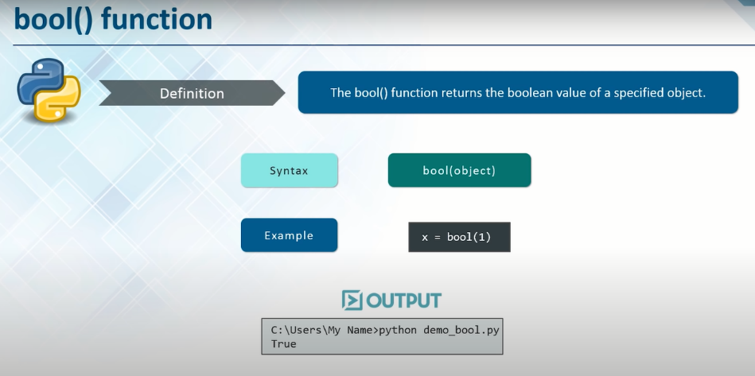

Slide 58
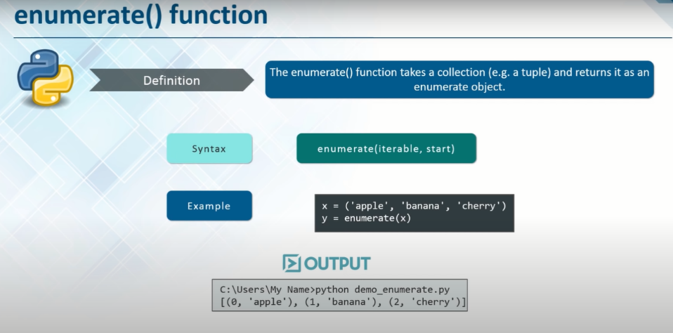

Slide 59
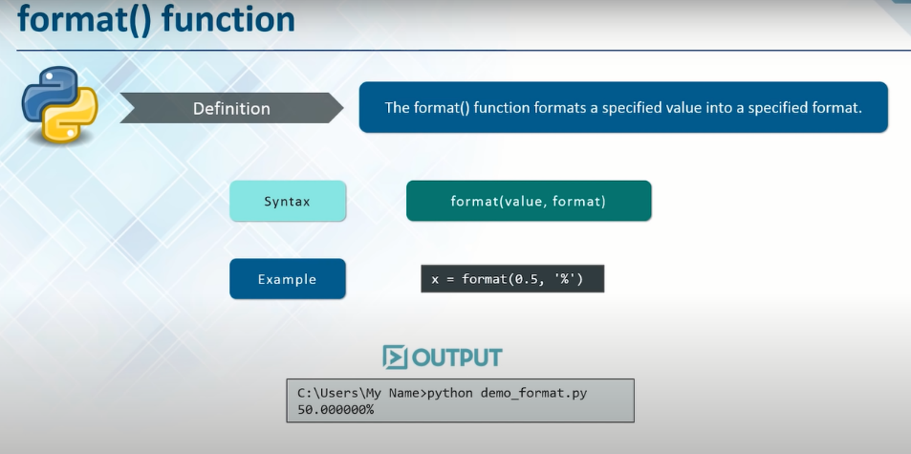

Slide 60
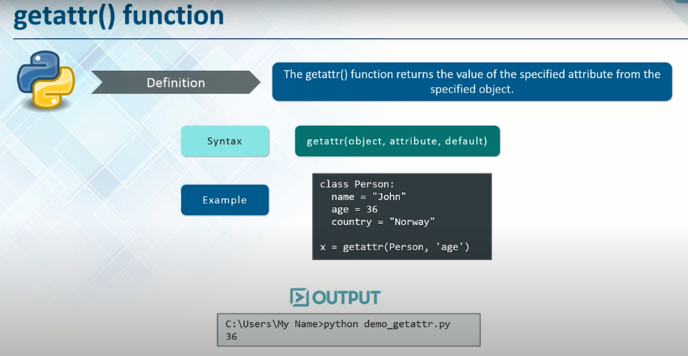

Slide 61
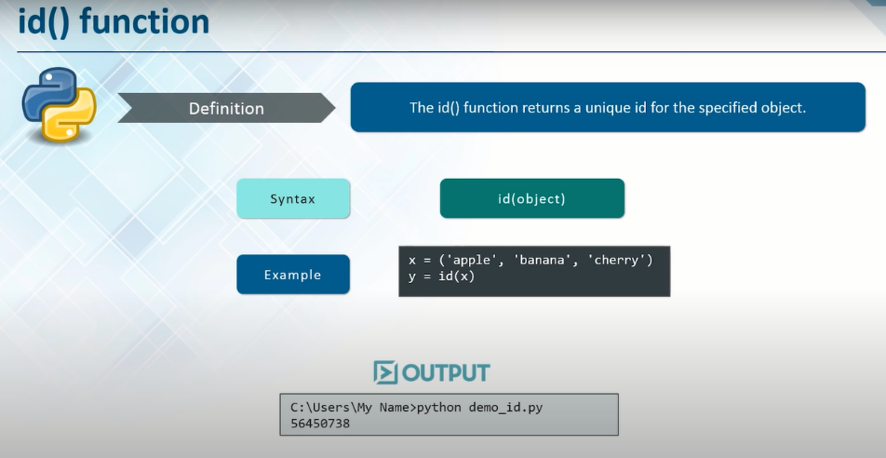

Slide 62
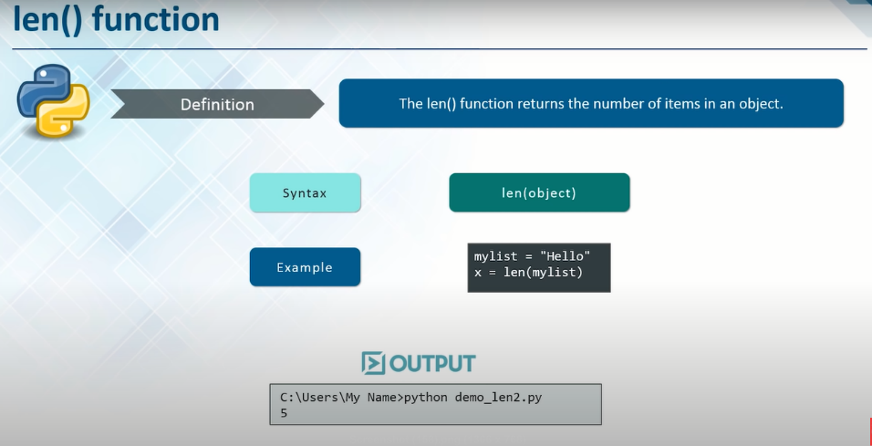

Slide 63
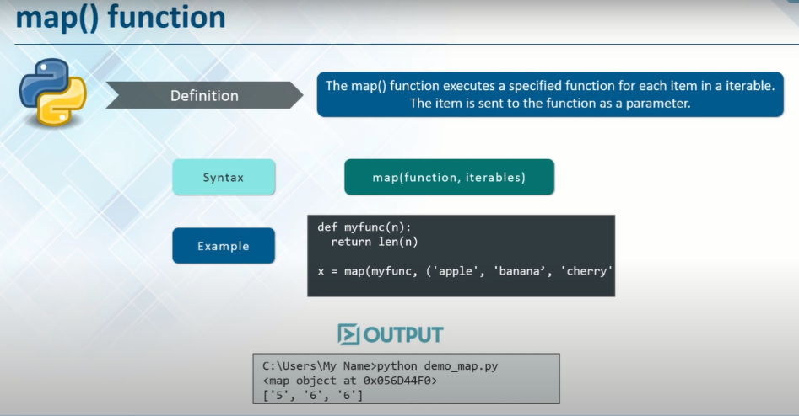

Slide 64
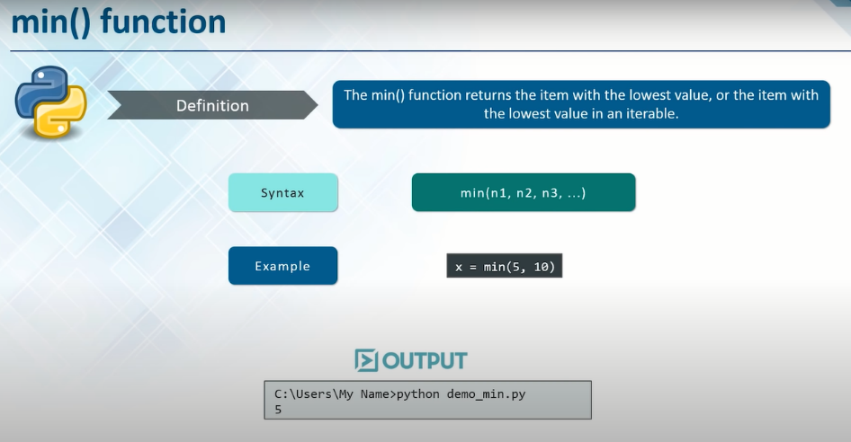

Slide 65
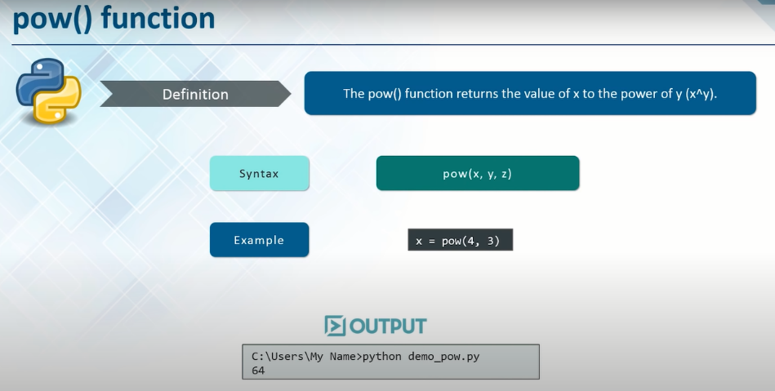

Slide 66
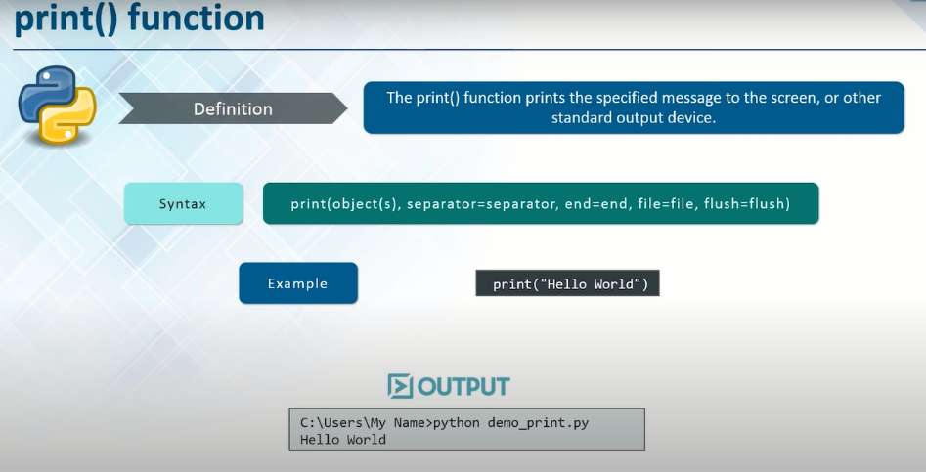

Slide 67


Slide 68


Slide 69


Slide 70

:User-Defined Functions: Functions that we define ourselves to do the certain specific task are referred to as user defined functions.

Slide 71


Slide 72


Slide 73


Slide 74

:Recursive Function: In Python, a function can call other functions. It is even possible for the function to call itself. These type of construct are termed as recursive functions.

Slide 75

:Lambda Function:

Slide 76


Slide 77


